Slide 1
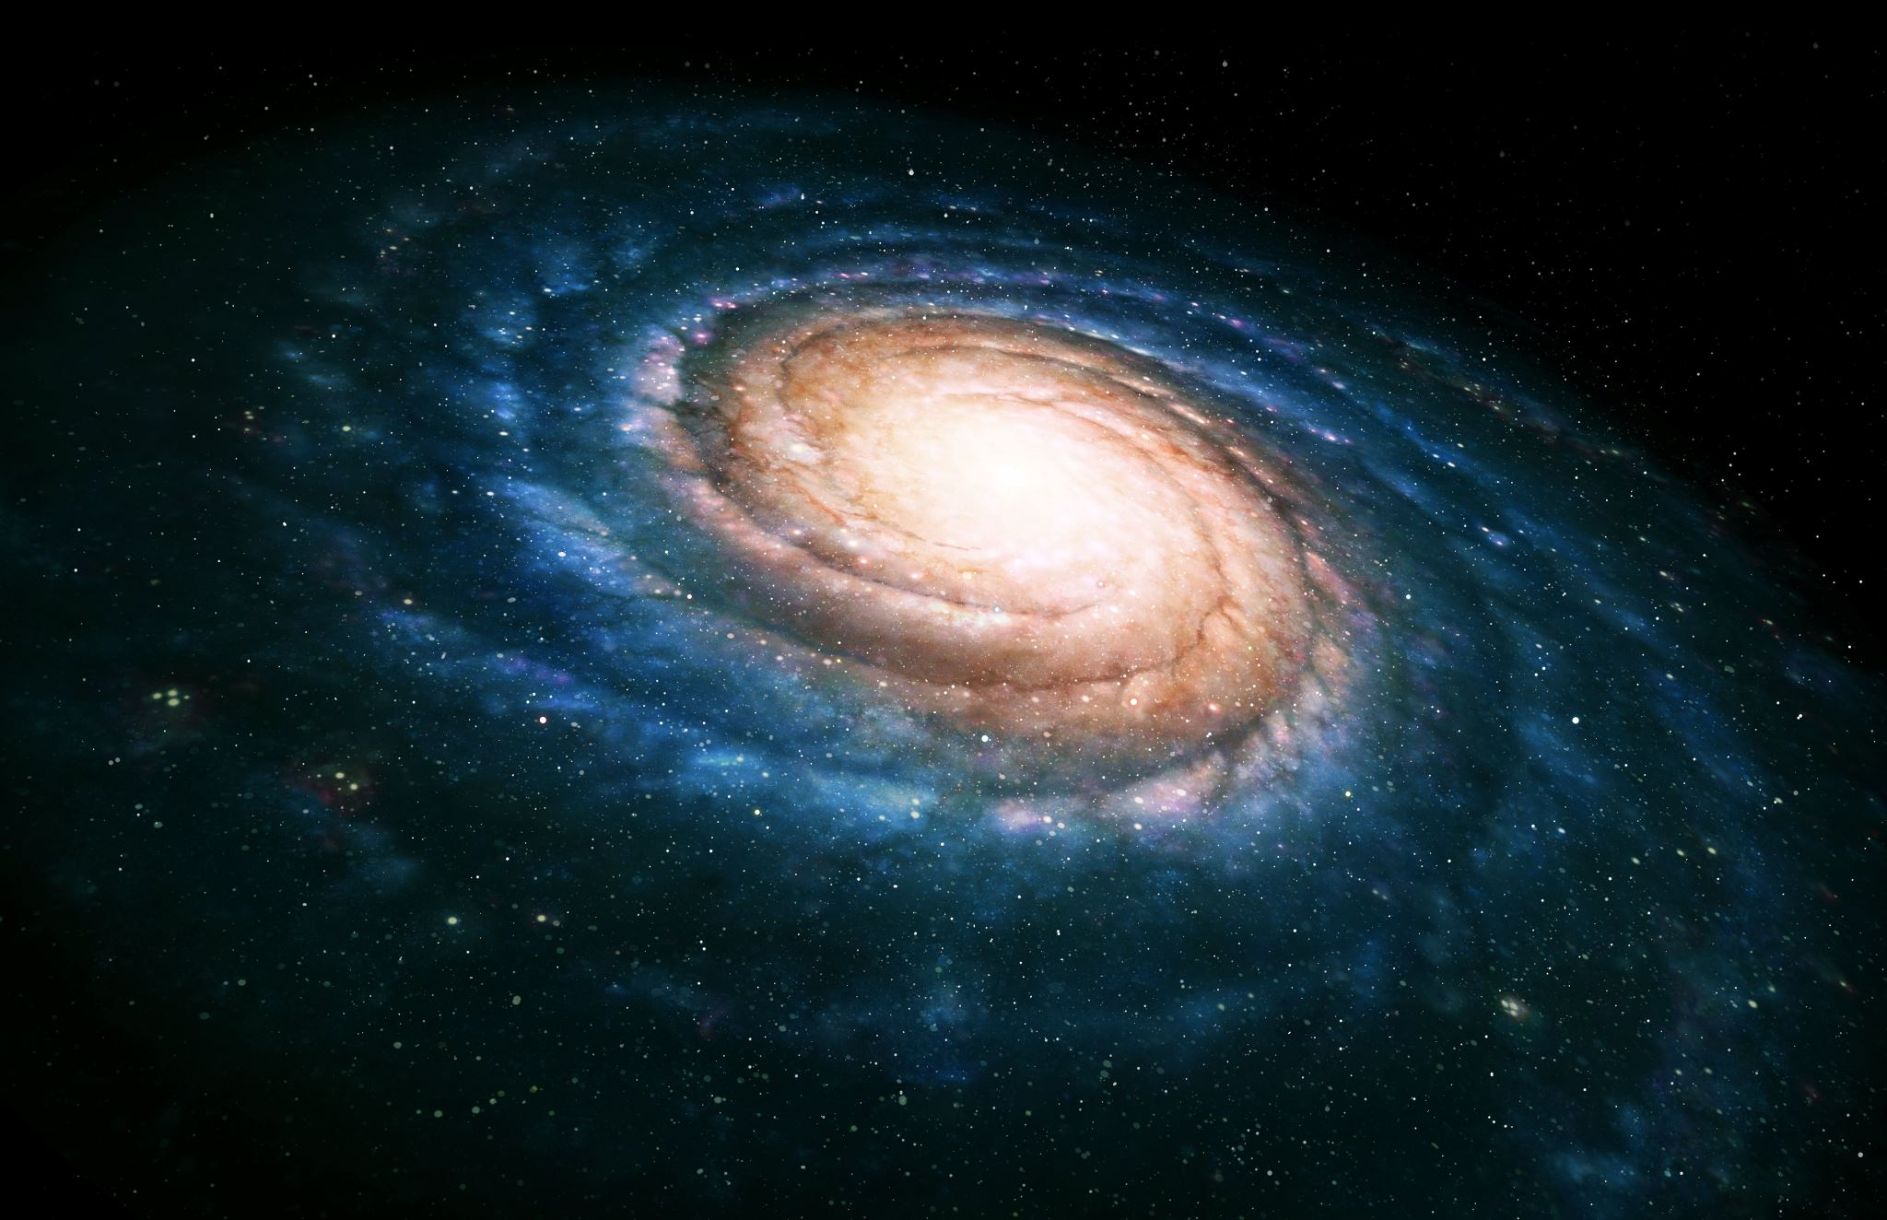
IN A PARALLEL UNIVERSE

